Slide 1
Lecture 1: Intro/Stable Matching
Nathan Brunelle and Glenn Sun

Slide 2
Intro/Logistics

Slide 3
About CSE 417
This is a course about algorithms.
Algorithm: A list of unambiguous instructions to solve a class of computational problems
In this class, we will:
Learn some specific noteworthy algorithms
Practice techniques to design algorithms for new problems
Communicate clearly why our algorithms work

Slide 4
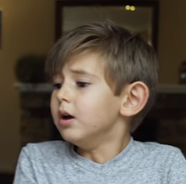



How it will sometimes feel
https://www.youtube.com/watch?v=cDA3_5982h8&t=245s
I quit!
Hopefully not you…

Slide 5

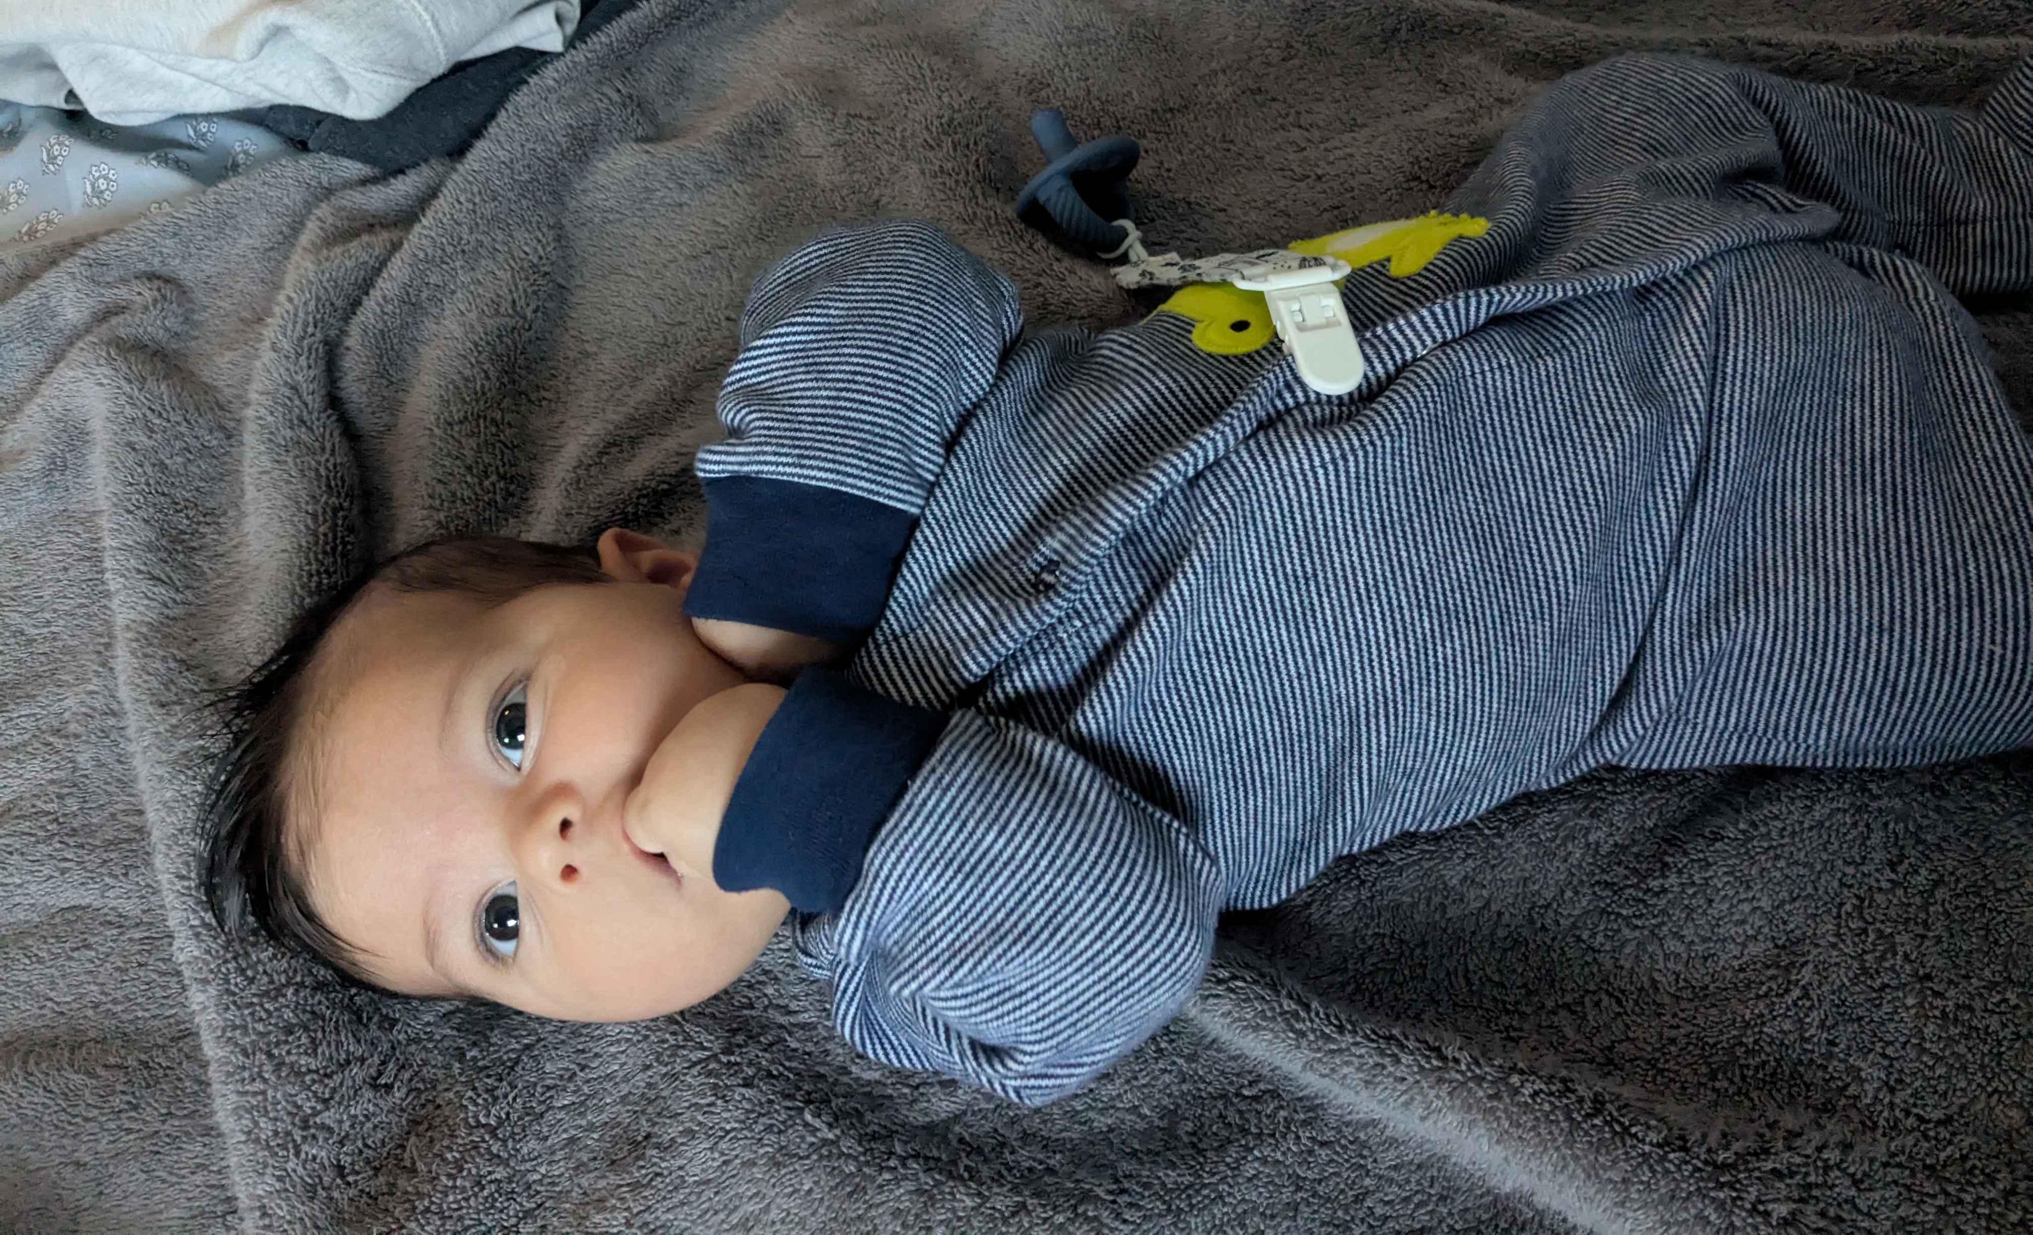
Nathan Brunelle
Associate Teaching Professor
Faculty at UVA 2017-2023 At UW since autumn 2023
I’ve mostly taught courses on: Discrete Math Algorithms Data Structures Intro to Programming

Slide 6

Glenn Sun
3rd year PhD student
I study Boolean satisfiability (the topic of the last 2 weeks of this course!)
I’ve been teaching in various forms (math circles, HS summer camps, TAing) for ~6 years.

Slide 7





The TA Team
Zachary
Shayla
Evan
Katherine
Yuchen

Slide 8
Where to find things
Canvas: Primary place for all course content, such as submitting homework, lecture recordings, etc.
Ed Board: Questions and discussion with staff/other students
As necessary, items in Canvas will link to:
cs.uw.edu/417: Public course content
Gradescope: For a small number of assignments

Slide 9
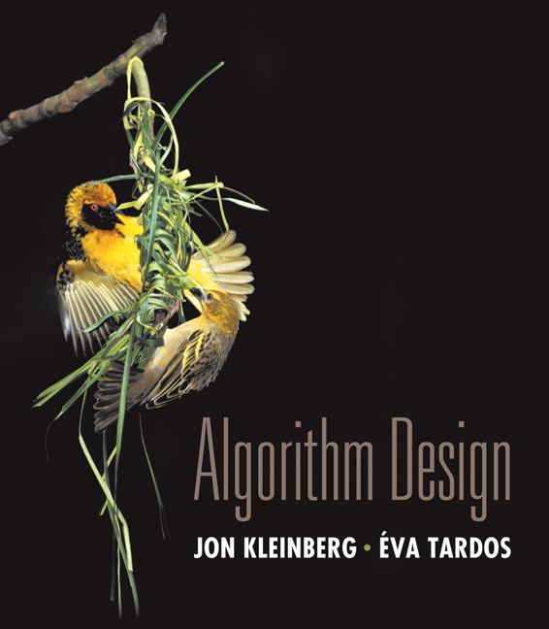
Textbook
Not required.
Optional reference: “Algorithm Design” by Jon Kleinberg and Éva Tardos

Slide 10
Homework
Pre-lecture reading + multiple choice concept check (10%): before every lecture
Standard homework (35%): 2 problems/week of algorithm design or similar longer-form mathematical work
Homework extensions (15%): 1 problem/week of programming assignments, discussion posts, or theoretical extensions
HW 1 will release this Friday, due next Friday!

Slide 11
Resubmissions/Late policy
HW released!
Due date (we start grading)
Resubmission deadline (solutions released)
7 days
12 more days

Slide 12
Assessments
Quiz 1 (10%): Friday, October 24, in class
Quiz 2 (10%): Friday, November 21, in class
Final Exam (20%): Monday, December 8
Please stress less!
Slightly easier problems than homework
Review session in the lecture slot before each assessment
Standard reference sheets provided
1-page note sheet permitted

Slide 13
Grading scheme
Excellent (E) | Demonstrates near-mastery of skills
Satisfactory (S) | Got the main idea, but details wrong/missing or other notable room for improvement
Nearing Satisfactory (N) | Missed a key idea, but making substantial progress towards to a solution
Unsatisfactory (U) | Wrong direction, minimal progress, or failed to follow instructions
Note: N grades contribute positively to final grades in CSE 417.

Slide 14
Collaboration
Feel free collaborate with anyone in this class!
“Whiteboard-only” collaboration:
Don’t take notes or take pictures when collaborating
Write up solutions individually at home from memory
Cite your collaborators!
Do not ask past students or LLMs for homework help.

Slide 15
Office hours
Please come!
Nathan/Glenn OH:
In-person OH: Lecturer holds after every class for 1 hr
Online OH: Non-lecturer holds 30 min after every class for 1 hr
View TA’s schedules on Canvas or cs.uw.edu/417/oh.
Read “Guide to Office Hours” on Canvas or cs.uw.edu/417/guides.

Slide 16
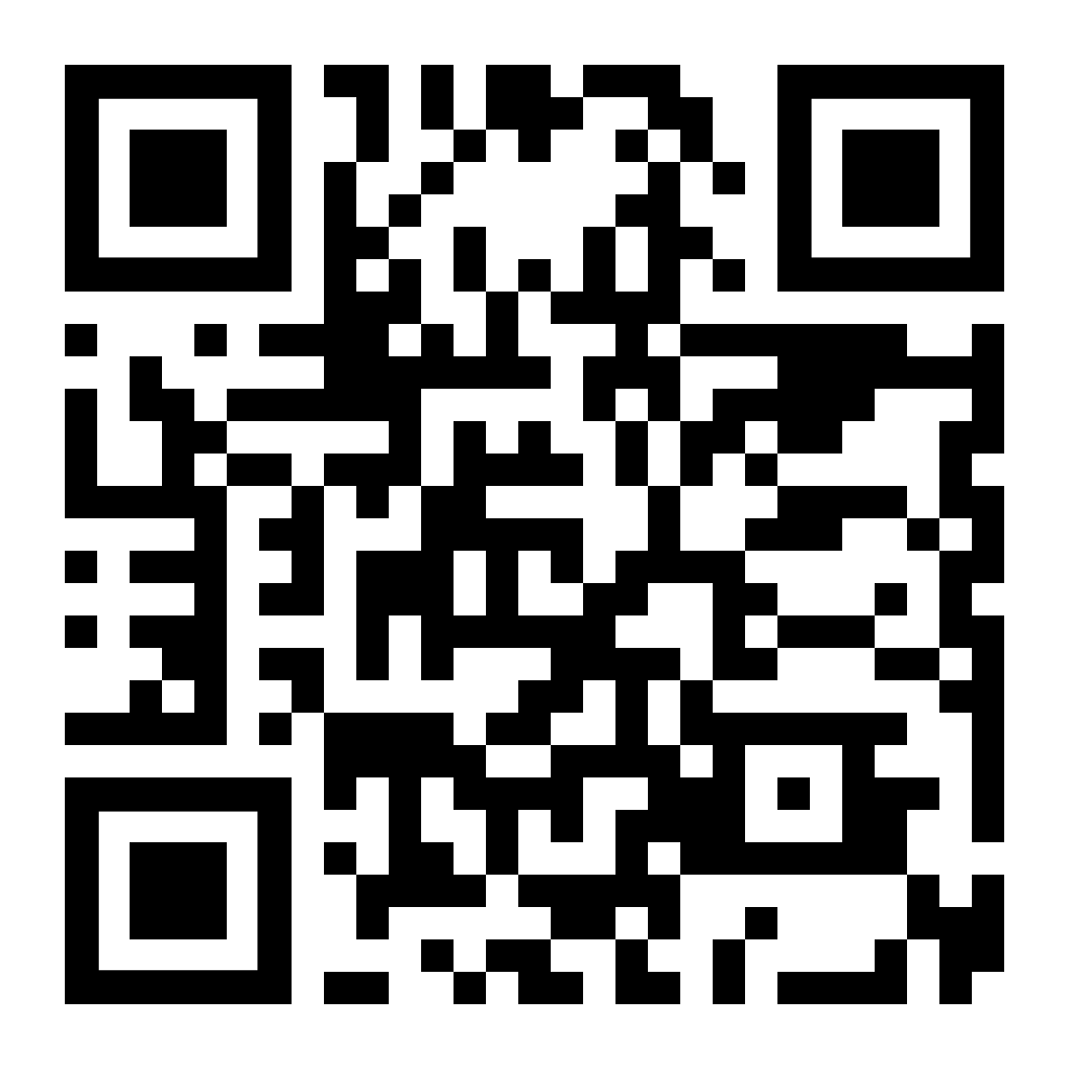
Anonymous feedback
feedback.cs.washington.edu
“nathan is so cool!”
“reading took me 1 hr :/”
“lecture today was really rushed :(”
“more examples please!”

Slide 17
More details
For information about…
ESNU to GPA minimum guarantees
Accommodations and related procedures
Details for everything we talked about so far
Etc.
Please see the syllabus on Canvas or course website:
cs.uw.edu/417/syllabus

Slide 18
Stable Matching

Slide 19
Matching medical residents to hospitals (1/2)
Input: Preferences of hospitals and medical school residents Goal: A self-reinforcing admissions process
🏥
🏥
🧑‍⚕️
🧑‍⚕️
🧑‍⚕️
🧑‍⚕️
🧑‍⚕️

Slide 20
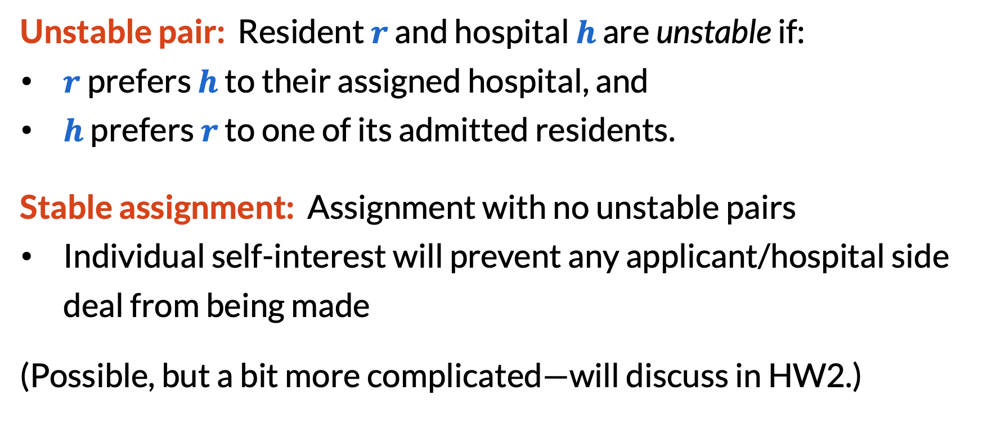
Matching medical residents to hospitals (2/2)
Unstable pair: Resident $r$ and hospital $h$ are unstable if:
​$r$ prefers $h$ to their assigned hospital, and
​$h$ prefers $r$ to one of its admitted residents.
Stable assignment: Assignment with no unstable pairs
Individual self-interest will prevent any applicant/hospital side deal from being made
(Possible, but a bit more complicated—will discuss in HW2.)

Slide 21
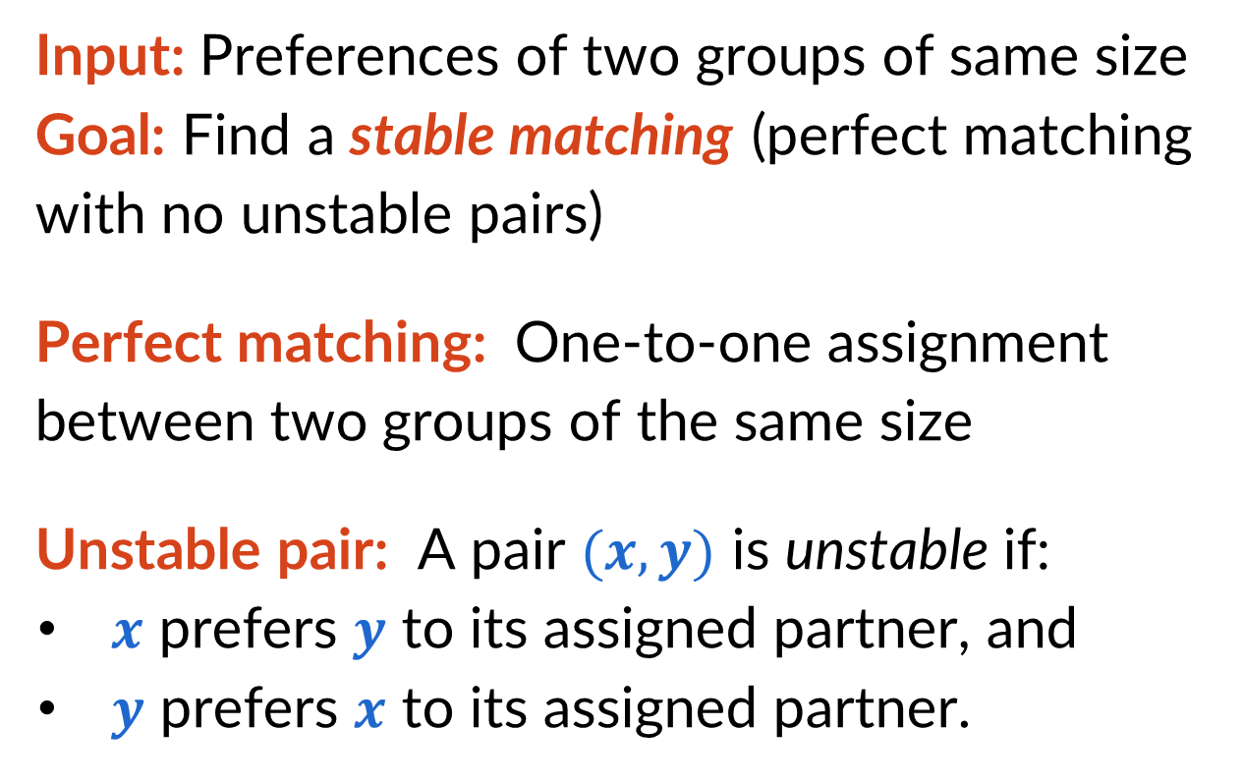
Simplification: Stable matching problem
Input: Preferences of two groups of same size Goal: Find a stable matching (perfect matching with no unstable pairs)
Perfect matching: One-to-one assignment between two groups of the same size
Unstable pair: A pair $(x,y)$ is unstable if:
​$x$ prefers $y$ to its assigned partner, and
​$y$ prefers $x$ to its assigned partner.
🧑‍🦳
🧑‍🦱
👩‍🦳
👩‍🦱
👨‍🦳
👨‍🦱

Slide 22
Stable matching examples (1/3)
Example input:
Q: Is matching (1, C), (2, B), (3, A) stable?
1: | A | > | B | > | C
2: | B | > | A | > | C
3: | A | > | B | > | C
A: | 2 | > | 1 | > | 3
B: | 1 | > | 2 | > | 3
C: | 1 | > | 2 | > | 3

Slide 23
Stable matching examples (1/3)
Example input:
Q: Is matching (1, C), (2, B), (3, A) stable? A: No, (1, B) is an unstable pair.
1: | A | > | B | > | C
2: | B | > | A | > | C
3: | A | > | B | > | C
A: | 2 | > | 1 | > | 3
B: | 1 | > | 2 | > | 3
C: | 1 | > | 2 | > | 3

Slide 24
Stable matching examples (2/3)
Example input:
Q: Is matching (1, A), (2, B), (3, C) stable?
A: Yes (can brute-force check, or see that the only number who could improve is 3, but all letters dislike 3 the most.)
1: | A | > | B | > | C
2: | B | > | A | > | C
3: | A | > | B | > | C
A: | 2 | > | 1 | > | 3
B: | 1 | > | 2 | > | 3
C: | 1 | > | 2 | > | 3

Slide 25
Stable matching examples (3/3)
Example input:
Q: Is matching (1, B), (2, A), (3, C) stable?
A: Also yes!
1: | A | > | B | > | C
2: | B | > | A | > | C
3: | A | > | B | > | C
A: | 2 | > | 1 | > | 3
B: | 1 | > | 2 | > | 3
C: | 1 | > | 2 | > | 3

Slide 26
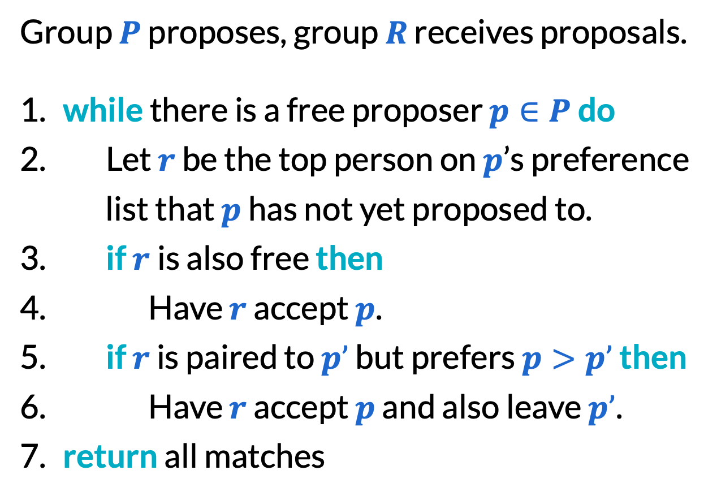
Gale–Shapley algorithm
Example:
1: | A | > | B | > | C
2: | B | > | A | > | C
3: | A | > | B | > | C
Group $P$ proposes, group $R$ receives proposals.
​while there is a free proposer $p∈P$ do
Let $r$ be the top person on $p$’s preference list that $p$ has not yet proposed to.
​if $r$is also free then
Have $r$ accept $p$.
​if $r$ is paired to $p’$ but prefers $p>p’$ then
Have $r$ accept $p$ and also leave $p’$.
​return all matches
A: | 2 | > | 1 | > | 3
B: | 1 | > | 2 | > | 3
C: | 1 | > | 2 | > | 3
Tentative pairs:
1 | A
2 | B
3 | C

Slide 27
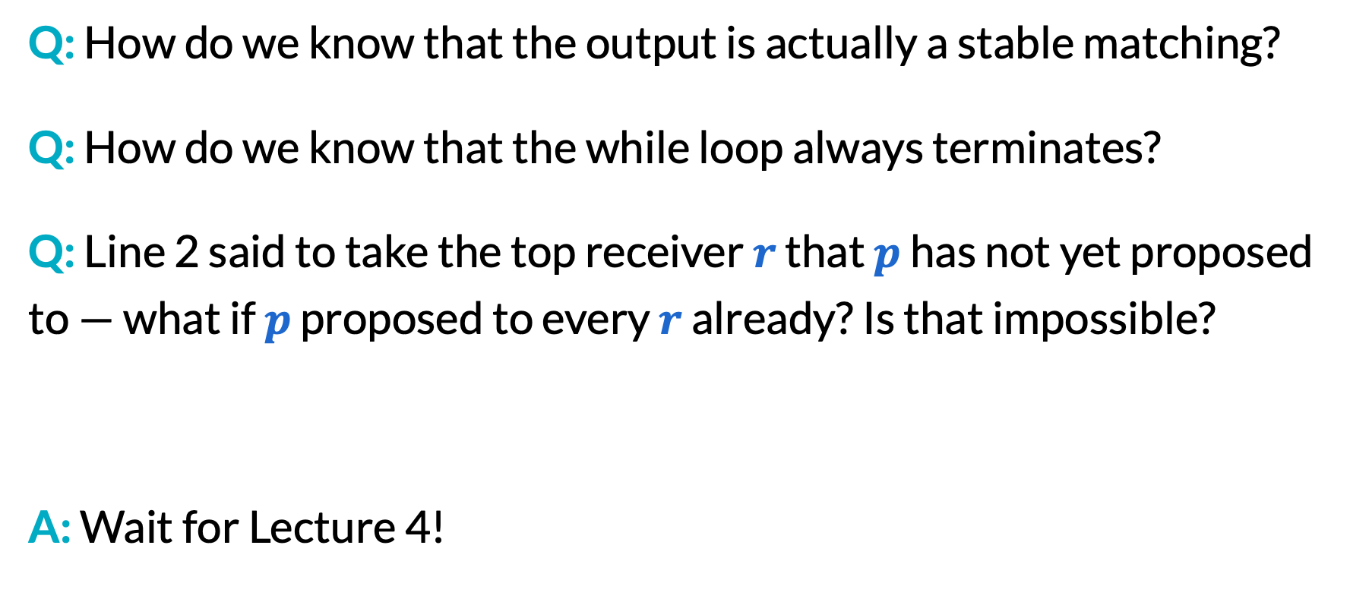
Questions about Gale–Shapley (1/3)
Q: How do we know that the output is actually a stable matching?
Q: How do we know that the while loop always terminates?
Q: Line 2 said to take the top receiver $r$ that $p$ has not yet proposed to — what if $p$ proposed to every $r$ already? Is that impossible?
A: Wait for Lecture 4!

Slide 28
Questions about Gale–Shapley (2/3)
Q: Is the Gale–Shapley algorithm a fair algorithm?
A: Potentially not. Recall our examples.
1: | A | > | B | > | C
2: | B | > | A | > | C
3: | A | > | B | > | C
A: | 2 | > | 1 | > | 3
B: | 1 | > | 2 | > | 3
C: | 1 | > | 2 | > | 3
Stable matching 1: (found by G–S)
1: | A | > | B | > | C
2: | B | > | A | > | C
3: | A | > | B | > | C
A: | 2 | > | 1 | > | 3
B: | 1 | > | 2 | > | 3
C: | 1 | > | 2 | > | 3
Stable matching 2: (not found by G–S)

Slide 29
Questions about Gale–Shapley (3/3)
Proposer optimality theorem: The Gale–Shapley algorithm always finds the unique stable matching that is both best for proposers and worst for receivers.
(Some sources will state G–S for men/women and marriage, but this algorithm should not be used for this application.)

Slide 30
Your To-Do List
Say hello on Ed!
Read the syllabus fully, on Canvas and cs.uw.edu/417
Complete the pre-class reading and concept check on Canvas before Friday’s lecture
Homework 1 will be released after Friday’s lecture!

